Slide 1
UWP training
Wojciech Tompalski
Tymon Marchwicki

Slide 2


Tymon Marchwicki
Wojciech Tompalski

Slide 3
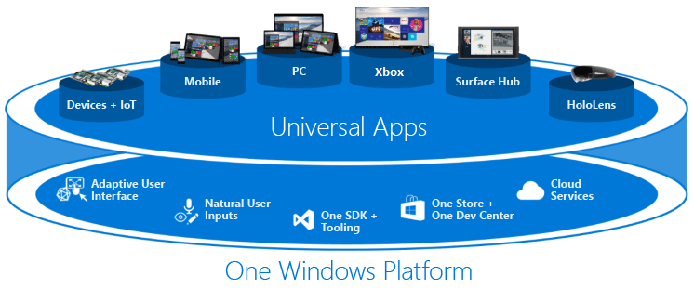
Universal Windows Platform
more than 1 bilion devices running Windows 10
85% adoption level

Slide 4
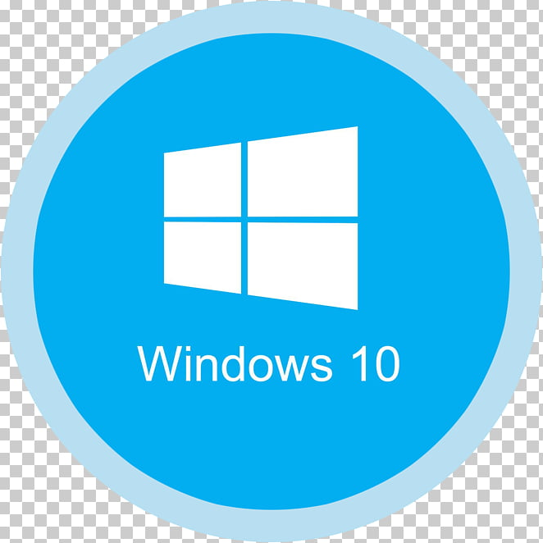
Xbox 360
Xbox One
WinRT
Windows 8.1
Windows 7
Windows
Phone 8.1
Windows Phone 8
(WinPRT)
Windows Phone 7.5
Windows on Devices
Credits: Andreas Velvart https://app.pluralsight.com/library/courses/windows-10-universal-apps-xam

Slide 5
Universal Windows Platform
Secure
Common API
Adapts the UI
Available from the Microsoft Store
Able to be installed and uninstalled gracefully
Engaging
Programmable in various technologies

Slide 6
Universal Windows Platform
XAML
C#
Extensible Application Markup Language

Slide 7
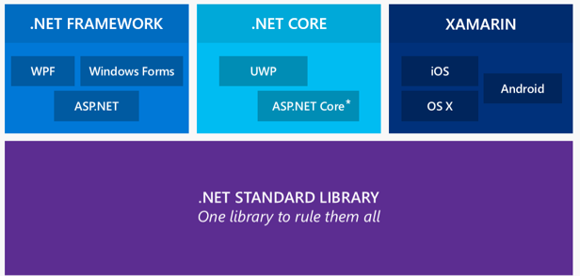
Universal Windows Platform

Slide 8
Universal Windows Platform
.NET Standard | 1.0 | 1.1 | 1.2 | 1.3 | 1.4 | 1.5 | 1.6 | 2.0 | 2.1
.NET Core | 1.0 | 1.0 | 1.0 | 1.0 | 1.0 | 1.0 | 1.0 | 2.0 | 3.0
.NET Framework ¹ | 4.5 | 4.5 | 4.5.1 | 4.6 | 4.6.1 | 4.6.1 ² | 4.6.1 ² | 4.6.1 ² | N/A³
Mono | 4.6 | 4.6 | 4.6 | 4.6 | 4.6 | 4.6 | 4.6 | 5.4 | 6.4
Xamarin.iOS | 10.0 | 10.0 | 10.0 | 10.0 | 10.0 | 10.0 | 10.0 | 10.14 | 12.16
Xamarin.Mac | 3.0 | 3.0 | 3.0 | 3.0 | 3.0 | 3.0 | 3.0 | 3.8 | 5.16
Xamarin.Android | 7.0 | 7.0 | 7.0 | 7.0 | 7.0 | 7.0 | 7.0 | 8.0 | 10.0
Universal Windows Platform | 10.0 | 10.0 | 10.0 | 10.0 | 10.0 | 10.0.16299 | 10.0.16299 | 10.0.16299 | TBD
Unity | 2018.1 | 2018.1 | 2018.1 | 2018.1 | 2018.1 | 2018.1 | 2018.1 | 2018.1 | TBD

Slide 9
Universal Windows Platform
Controls Gallery
https://github.com/Microsoft/Xaml-Controls-Gallery
Documentation
https://docs.microsoft.com/en-us/windows/uwp
Samples
https://github.com/Microsoft/Windows-universal-samples

Slide 10
Topics
Win10 App Lifecycle
Project setup
Debugging
Text localization
Publishing
Layout
Data binding
Navigation
Handling touch events
Handling keyboard
Inking API
Accessing sensors
Notifications
Splash screen
Storage
Services
Suspending the app
Consuming IO
Security
Logging
Tests

Slide 11
Topics – Day 1
Project setup
Layout
Data binding
Windows App Certification Tool
Creating App Packages and Publishing
Remote Debugger

Slide 12
Project setup

Slide 13
XAML and UI

Slide 14
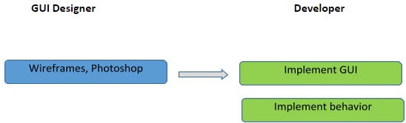
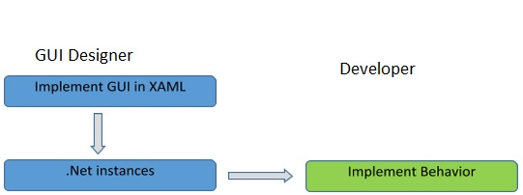
XAML
Typical GUI frameworks
XAML
Graphics: https://www.tutorialspoint.com/xaml/xaml_overview.htm

Slide 15
XAML
Extensible Application Markup Language
variant of XML for describing GUI (must be valid XML)
unlike XML supports property element syntax
<Page
x:Class="MyApp.Main" xmlns="http://schemas.microsoft.com/winfx/2006/xaml/presentation"
xmlns:x="http://schemas.microsoft.com/winfx/2006/xaml"
xmlns:local="using:MyApp"
xmlns:d="http://schemas.microsoft.com/expression/blend/2008"
xmlns:mc="http://schemas.openxmlformats.org/markup-compatibility/2006"
mc:Ignorable="d"
Background="{ThemeResource ApplicationPageBackgroundThemeBrush}">
<Grid>
<Button Content="Button Test" Click="Button_Click"/>
<TextBox Text="{x:Bind Title}" TextWrapping="Wrap"/>
</Grid>
</Page>
[XmlnsDefinitionAttribute("http://yournamespace/", "Your.Assembly.Namespace")]

Slide 16
XAML
Scope
Controls
Panels
Resources
Styles
Templates
Animations + Transformations
Notes:
Objects: Containers / UI Elements / Resource Dictionaries
Resources: definitions to some object used more than once
Styles: multiple strategies
Templates: the overall look
Windows Community Toolkit + Microsoft.UI.Xaml + XAML Controls Gallery

Slide 17
XAML
Panels
Grid
RelativePanel
StackPanel
ScrollViewer
VariableSizedWrapGrid
Canvas
Notes:
Objects: Containers / UI Elements / Resource Dictionaries
Resources: definitions to some object used more than once
Styles: multiple strategies
Templates: the overall look

Slide 18
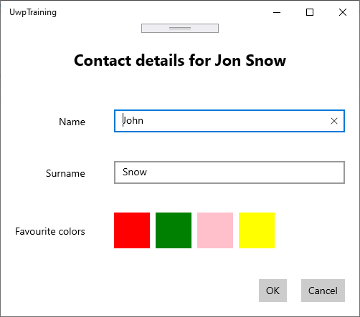
XAML
Exercise (30 min)
Create view that looks like this

Slide 19
Data Binding

Slide 20
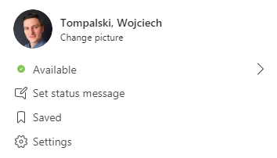
Data binding
Types of binding
one-time
one-way
two-way
Doing things

Slide 21
Data binding
Types of binding
one-time
one-way
two-way
Doing things

Slide 22
Data binding
Binding pieces
binding source
binding target
binding object
<TextBox Text="{x:Bind Album.Title}" />
generated in code behind

Slide 23
Data binding
x:Bind vs Binding
← new, compile-time (faster)
<TextBox Text="{x:Bind Title}" />
binds to code-behind class
needs all types fixed at compile time
defaults to faster OneTime mode
<TextBox Text="{Binding Title}" />
binds to the DataContext
binds to a Property Name, flexible about the actual source type
← older, run-time (slower)

Slide 24
BindableBase
https://github.com/microsoft/Windows-appsample-networkhelper/blob/master/DemoApps/QuizGame/Common/BindableBase.cs

Slide 25
Resources

Slide 26
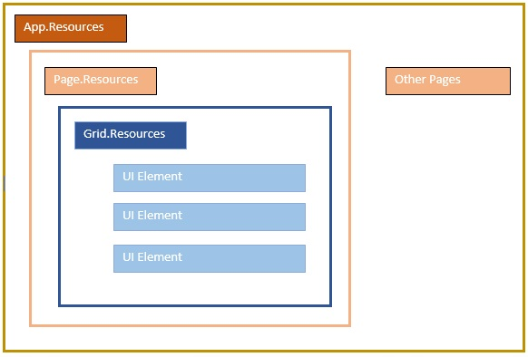
Graphics: https://www.tutorialspoint.com/xaml/xaml_resources.htm

Slide 27
Styles

Slide 28
Templates

Slide 29
Universal Windows Platform
DataTemplate
ControlTemplate

Slide 30
Converters

Slide 31
Converters
Exercise (20 minutes)
Add button Toggle Colors to show or hide colors
→ Problem: Visibility takes Visibility enum
2. Install Microsoft.Toolkit.Uwp.UI nuget
→ Use BoolToVisibilityConverter

Slide 32
Dependency Properties

Slide 33
Attached Properties

Slide 34
Commands

Slide 35
Topics – Day 2
Part 1
Part 2
App Lifecycle
Background Tasks
Storage
Notifications
MVVM + Messaging
IoC + Navigation
Showing dialogs
Adaptive UI
Gesture Recognizer

Slide 36
Topics – Time line
9:00 – 11:30 Part 1
11:30 – 12:00 Break
12:00 – 14:00 Part 2
14:00 – 15:00 Lunch
15:00 – 17:00 Part 1 / Part 2

Slide 37
App Lifecycle

Slide 38
App Lifecycle
Win32 apps
Not running
start
Running
stop

Slide 39
App Lifecycle
Running in foreground
UWP apps
Ways to continue work:
Background Tasks
Extended Execution
Sponsored Activity
enter
leave
Not running
activate
Running in background
suspend
resume
terminate
Suspended

Slide 40
App Lifecycle
Activation
vs
Launching
Activated by the contract
Activated by the user / system
OnActivated
OnCachedFileUpdaterActivated
OnFileActivated
OnFileOpenPickerActivated OnFileSavePickerActivated
OnSearchActivated
OnShareTargetActivated
OnLaunched
LaunchActivatedEventArgs
.PreviousExecutionState:
NotRunning
Suspended
Terminated
ClosedByUser
Running

Slide 41
App Lifecycle
LeavingBackground
EnteringBackground
best place to verify if UI is ready
ensure first UI frame
long-runners then asynchronously
reduce memory usage
save data (asynchronously, mind the deferrals)
start background work

Slide 42
App Lifecycle
Suspending
Resuming
previously used to save state
(now EnteringBackground)
release exclusive resources:
cameras
I/O devices
external devices
network resources
release file handlers
be aware of timeout
prevented by the debugger
resume file handlers
resume exclusive resources
not called if terminated
called outside the UI thread
Terminate
dedicated method/handler does not exist
Launch will be called once re-started

Slide 43
Background tasks

Slide 44
Background work
Background tasks
In-process
Out-of-process
Introduced in Windows 10 ver. 1607
Runs in the same proces as foreground app
No cross proces communication required
Does not require manifest
Uses separate proces to run
More resilient, as crashing of the process does not crash the app
Still needed for some triggers (VOIP, IoT sensors etc.)

Slide 45
Background work
Triggers
: IBackgroundTrigger
Application (manual task trigger)
System (InternetAvailable, NeworkStateChange, SmsReceived…)
Location (geofencing)
Notification
Time (once or in intervals, 15 min. granularity)
Conditions
= SystemConditionType
Internet(Not)Available (+ IsNetworkRequested!)
SessionConnected/Disconnected
User(Not)Present
Notes:
Define UI
Define Constants

Slide 46
Toast
Exercise (30 minutes)
Create view BackgroundTasks with buttons Register and Run
Register in-proces background task (with Debug.WriteLine)

Slide 47
Storage

Slide 48
Application Data
App Data
User Data
vs

Slide 49
Application Data
App Data
App installed = per-user data stores created
Data isolated from other apps and users
Managed by the system
App removed = data lost
Don’t store valuable user data
Store app-specific user preferences, settings, and favorites
Accessible with ms-appdata://local
Notes:
Excercise: pick any picture, copy to local and display

Slide 50
Application Data
App Data
Settings
Files
Local
Roaming
Local
Roaming
Cache
Temporary

Slide 51
Application Data
Settings
UInt8, Int16, UInt16, Int32, UInt32, Int64, UInt64, Single, Double
Boolean
Char16, String
DateTime, TimeSpan (System.DateTimeOffset, System.TimeSpan)
GUID, Point, Size, Rect
ApplicationDataCompositeValue
Notes:
UInt8, Int16, UInt16, Int32, UInt32, Int64, UInt64, Single, Double
Boolean
Char16, String
DateTime, TimeSpan (System.DateTimeOffset, System.TimeSpan)
GUID, Point, Size, Rect
ApplicationDataCompositeValue

Slide 52
Files
App can access files and folders:
from App Data
selected by FileOpenPicker or FolderPicker (user interaction!)
from MostRecentlyUsedList and FutureAccessList
special folders like Documents, Pictures, Videos
Downloads – creation only

Slide 53
Storage
Exercise (45 minutes)
Create new page Storage with list of files in local app data + Import buton
List of files lists files in local app data
Import button opens picker to select a picture
Copy selected picture to local app data (file.CopyAsync)
Let the list of files being updated

Slide 54
Database

Slide 55
Notifications

Slide 56
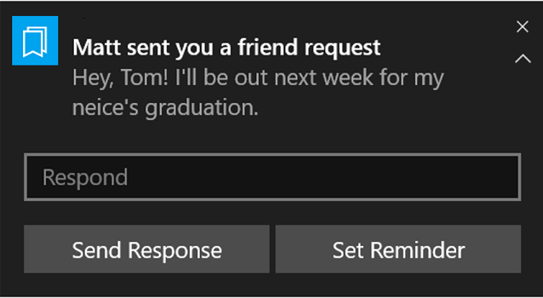
Toast

Slide 57
Toast
Toasts
Can be scheduled
Can have no popup – go to Action Center
Can be triggered by raw notification
Can have action – no need to open the app
Live in Action Center up to 3 days
Can be deleted programmatically

Slide 58
Toast
Sending a toast
Constructing the visual part (text and image) of the notification
Adding actions to the notification
Setting an expiration time on the toast
Setting tag/group so you can replace/remove the toast at a later time
Sending your toast using the local APIs

Slide 59

Toast
Microsoft.Toolkit.Uwp.Notifications
QueryString.NET

Slide 60
Toast
<?xml version="1.0"?>
<toast launch="action=viewConversation&amp;conversationId=384928">
<visual>
<binding template="ToastGeneric">
<text>Alice sends you a cat picture</text>
<text>Look at this cuttie!</text>
<image src="http://placekitten.com/200/300"/>
<image src="ms-appdata:///local/kitten.jpg" placement="appLogoOverride" hint-crop="circle"/>
</binding>
</visual>
<actions>
<input id="tbReply" type="text" placeHolderContent="Type a response"/>
<action content="Reply" arguments="action=reply&amp;conversationId=384928" activationType="background"
imageUri="Assets/Reply.png" hint-inputId="tbReply"/>
<action content="Like" arguments="action=like&amp;conversationId=384928" activationType="background"/>
<action content="View"
arguments="action=viewImage&amp;imageUrl=https%3A%2F%2Fpicsum.photos%2F360%2F202%3Fimage%3D883"/>
</actions>
</toast>

Slide 61
Toast
Exercise (30 minutes)
Go back to BackgroundTasks
Create two new Buttons Register for Notifications + Show Toast
Register task with ToastNotificationActionTrigger
Run toast notification on background complete

Slide 62
IO

